Slide 1
Module 3.1
PRE-CLASS CONTENT
Rules of Inference

Slide 2
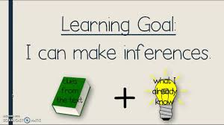

Inference

Slide 3
Valid Argument
Mathematical logic is often used for logical proofs.
Proofs are valid arguments that determine the truth values of mathematical statements.
An argument is a sequence of statements.
The last statement is the conclusion and all its preceding statements are called premises (or hypothesis).
The symbol “∴”, (read therefore) is placed before the conclusion.
A valid argument is one where the conclusion follows from the truth values of the premises.

Slide 4
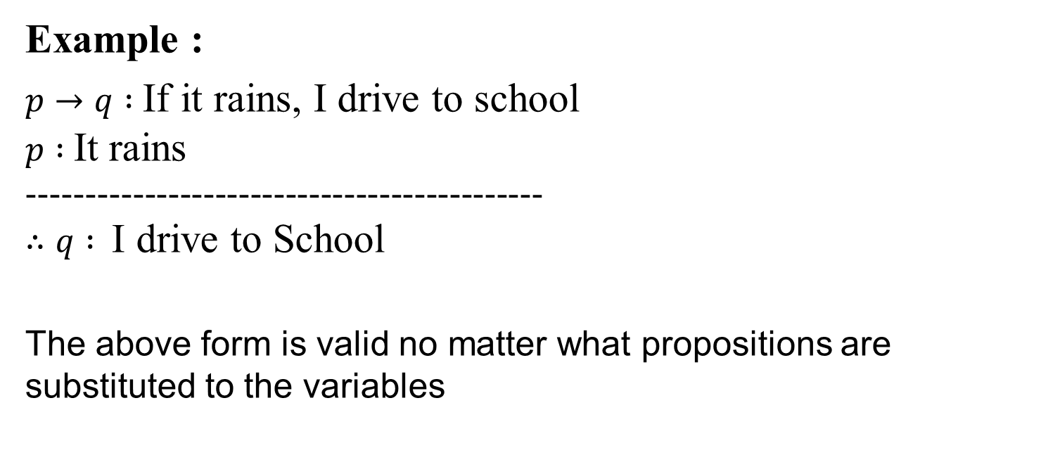
Valid Argument Form
Example :
$p→q :$If it rains, I drive to school
$p :$It rains
--------------------------------------------
$∴q :$ I drive to School
The above form is valid no matter what propositions are substituted to the variables

Slide 5
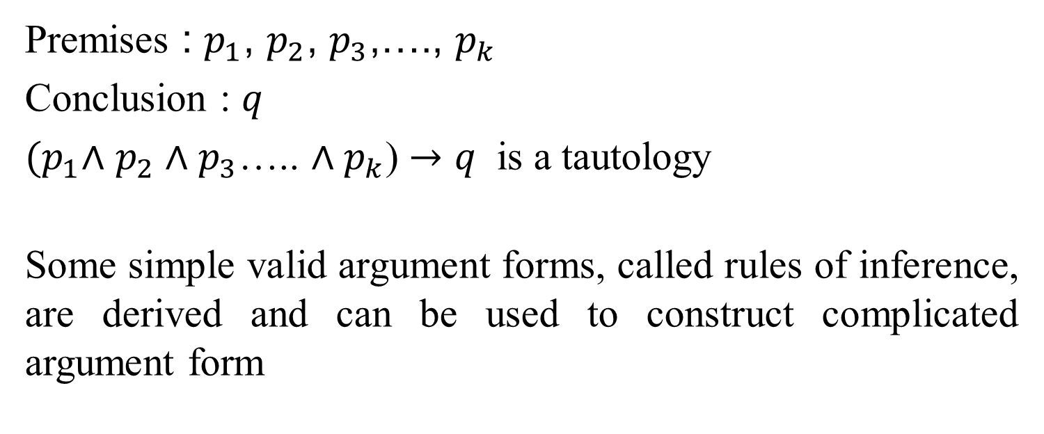
Valid Argument Form &Validity
Premises : $p_{1}$, $p_{2}$, $p_{3}$,…., $p_{k}$
Conclusion : $q$
${(p}_{1}∧$ $p_{2}∧$ $p_{3}$….. $∧p_{k}$) $→q$ is a tautology
Some simple valid argument forms, called rules of inference, are derived and can be used to construct complicated argument form

Slide 6
Why Rules of Inference?
Rules of Inference provide the templates or guidelines for constructing valid arguments from the statements that we already have.

Slide 7
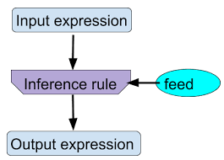
Logical paradigm

Slide 8
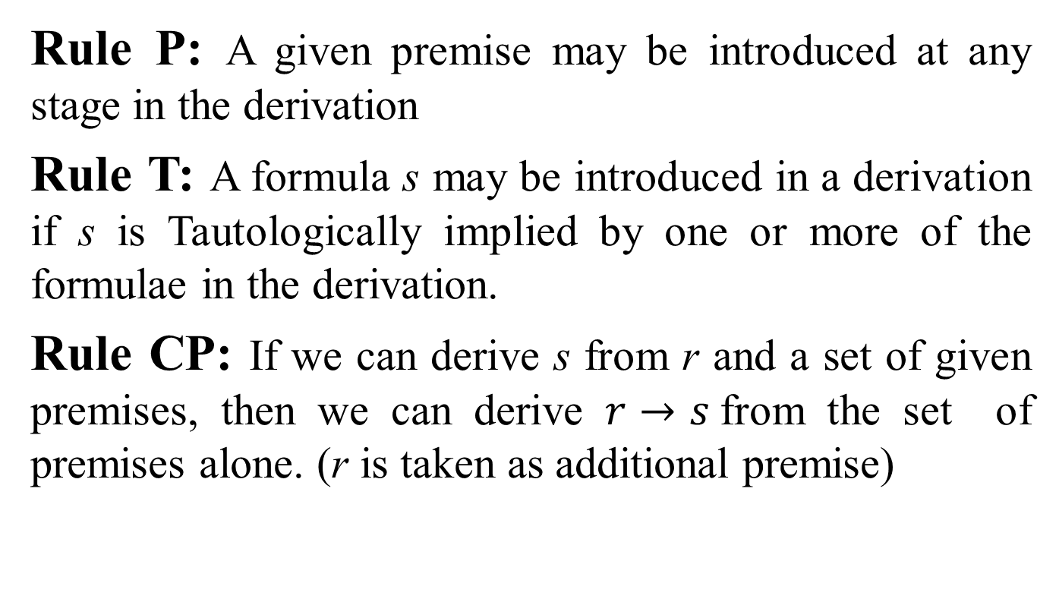
Rules of Inference theory
Rule P: A given premise may be introduced at any stage in the derivation
Rule T: A formula s may be introduced in a derivation if s is Tautologically implied by one or more of the formulae in the derivation.
Rule CP: If we can derive s from r and a set of given premises, then we can derive $r→s$from the set of premises alone. (r is taken as additional premise)

